Slide 1
Semantic Plagiarism Detection and Idea Validation Using RAG-Based Embeddings -Dharaniraj VM -Jayasuriya R -Sivasankaramoorthy R

Slide 2
01
Introduction

Slide 3
02
Problem Statement

Slide 4
Problem Statement
Validating the novelty of a thesis is a critical yet challenging task for academic institutions and PhD scholars. Universities and research committees often struggle to efficiently verify whether a submitted thesis presents a truly original contribution or if similar research already exists.
The current process of manually reviewing extensive academic literature is time-consuming and tedious, making it difficult to ensure academic integrity.
For PhD scholars, selecting a unique research problem is equally challenging. Existing plagiarism detection solutions primarily rely on keyword matching, which fails to capture semantic similarities between research topics, making them ineffective in identifying reworded or conceptually similar work.

Slide 5
03
SOCIAL RELEVANCE

Slide 6
Social relevance:
ADDRESSING CHALLENGES IN ACADEMIC RESEARCH:
Validating the novelty of PhD theses is a complex and time-consuming task for universities. Our system automates this process using advanced embedding-based retrieval, ensuring a more accurate and efficient validation of thesis originality.
PREVENTING REDUNDANT RESEARCH
Many PhD scholars unknowingly choose topics that have already been explored, leading to wasted time and effort. By providing a semantic similarity check, our system helps researchers identify whether a similar study already exists. This ensures that scholars can either refine their ideas or choose a truly novel research problem, fostering meaningful academic contributions.

Slide 7
Social relevance:
IMPACT ON EDTECH AND INNOVATION:
The integration of AI-driven RAG (Retrieval-Augmented Generation) in EdTech revolutionizes how institutions handle research validation. By automating the thesis evaluation process, universities can accelerate approvals, improve research efficiency, and maintain a digital repository of ideas
SMARTER RESEARCH ECOSYSTEM:
By reducing redundant research, promoting ethical research practices, and ensuring genuine contributions, this system helps create a smarter, technology-driven research environment. Ultimately, it saves time, boosts innovation, and strengthens the global research community.

Slide 8
Our Solution Challenges faced
We present the query to the model after preprocessing and connecting it to the translator.
Document chatting feature by developing a RAG based model
Web scraping to feed real time data to model’s knowledge.
Existing LLM;s provide document chatting voice recognition like features only for English and other high resource languages
Most of the language models that excelled in tamil answer generation were not free
Resources for code- mixed tamil were very less and that made the design complicated.

Slide 9
03
Tools and technologies

Slide 10
Tools and technologies used
Chat model
Llama-2 model intergrated using Huggingface Pipeline
Text generation pipeline from Transformers library
Torch: A deep learning framework to leverage GPU capabilities for model inference.
RAG based document model
PyMuDF – Extraction of content from PDF
FAISS vector store
MPNet model for embeddings creation
Huggingface embeddings
Conversational retrieval chain from Langchain

Slide 11
Tools and technologies used
Other features
Google Translate for translation
Google Cloud API
Teserract for OCR tamil
Web scraping
Beautiful Soup
Selenium
Requests library

Slide 12
04
System Architecture

Slide 13
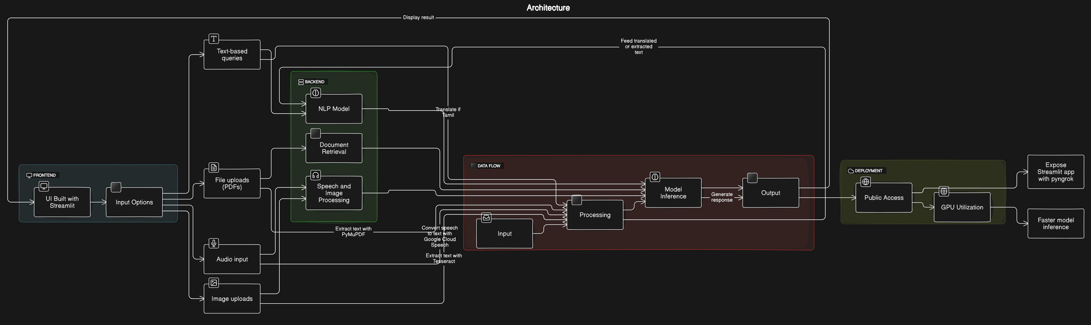
System Architecture:

Slide 14
05
Screenshots

Slide 15
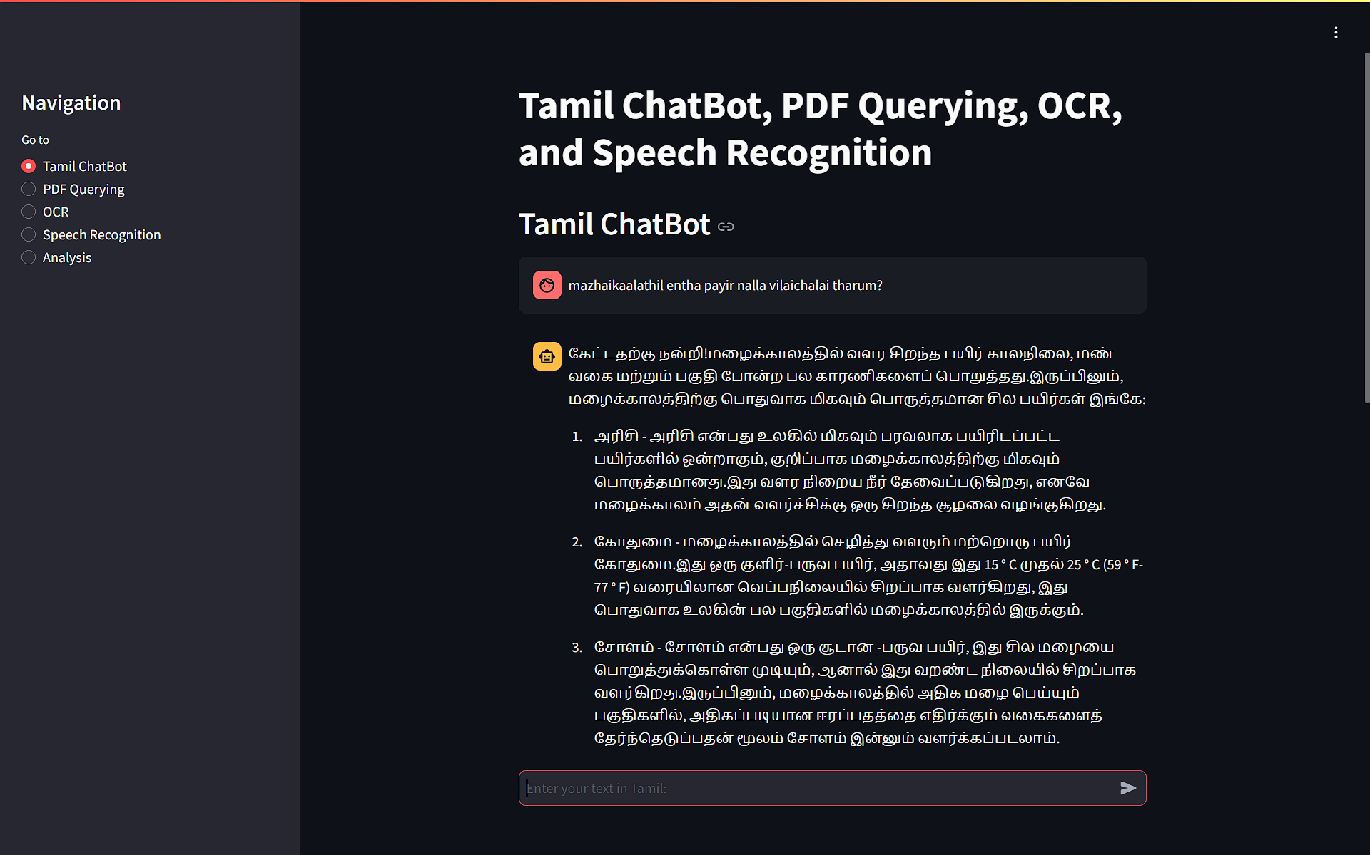
Screen Shots

Slide 16
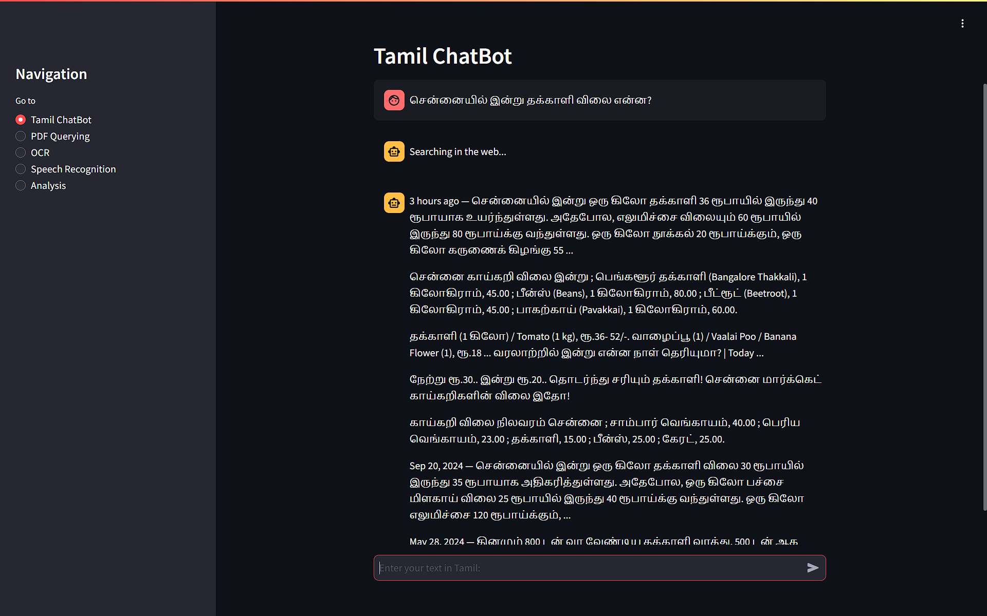

Slide 17
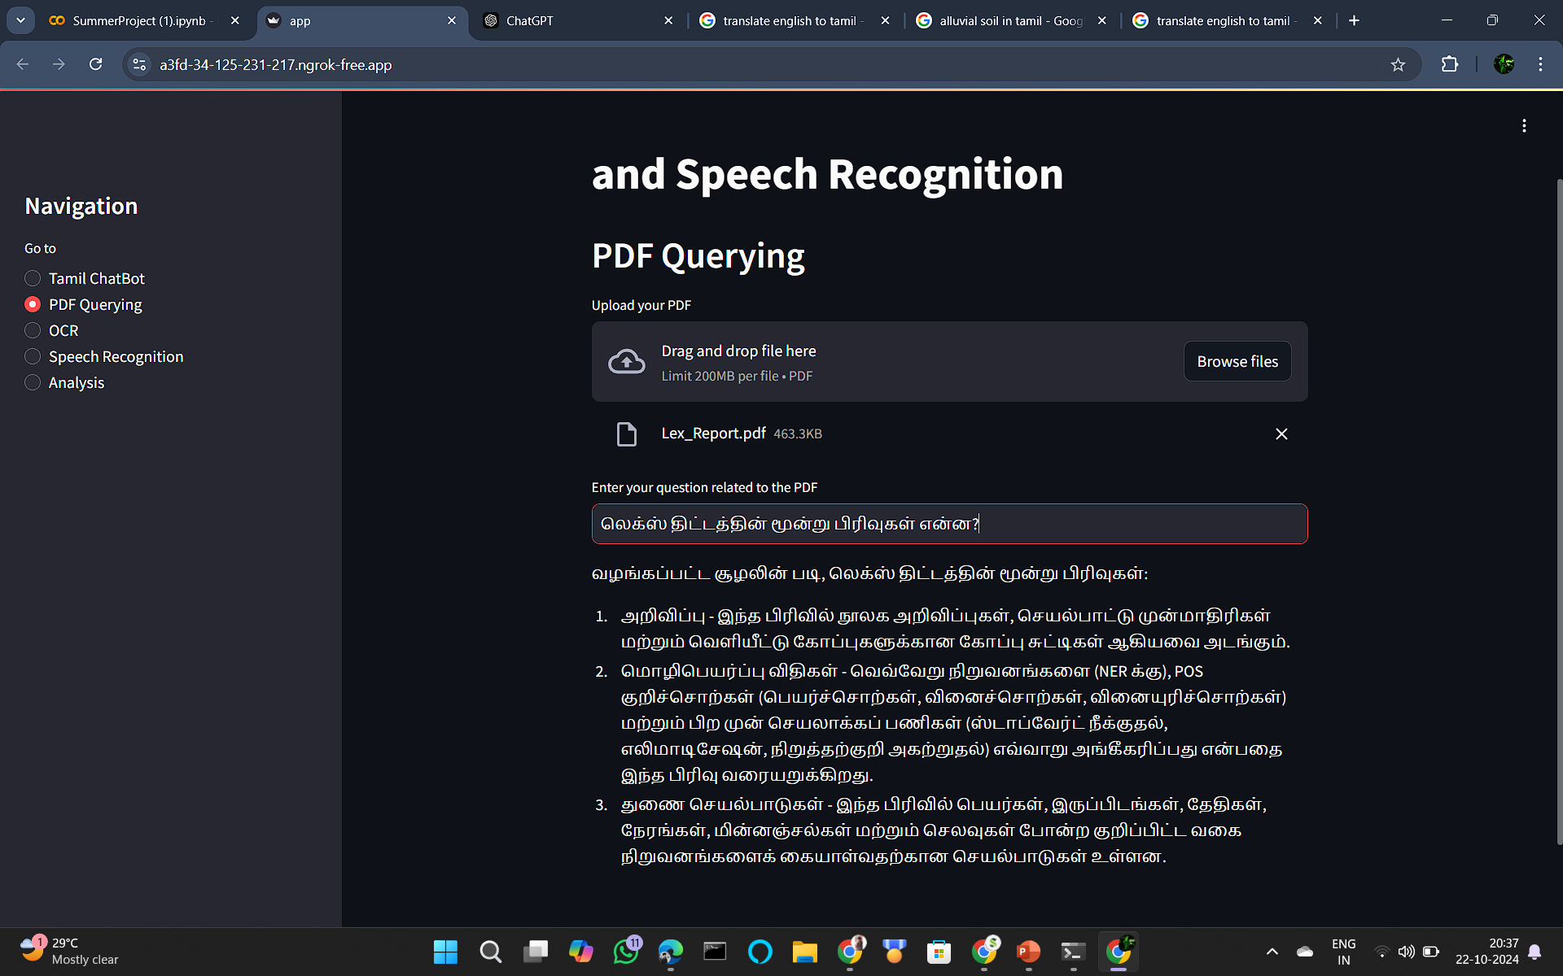

Slide 18
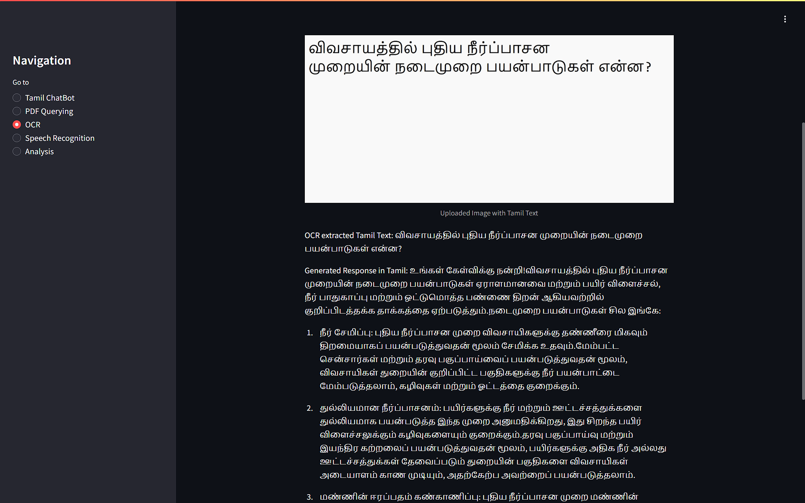

Slide 19
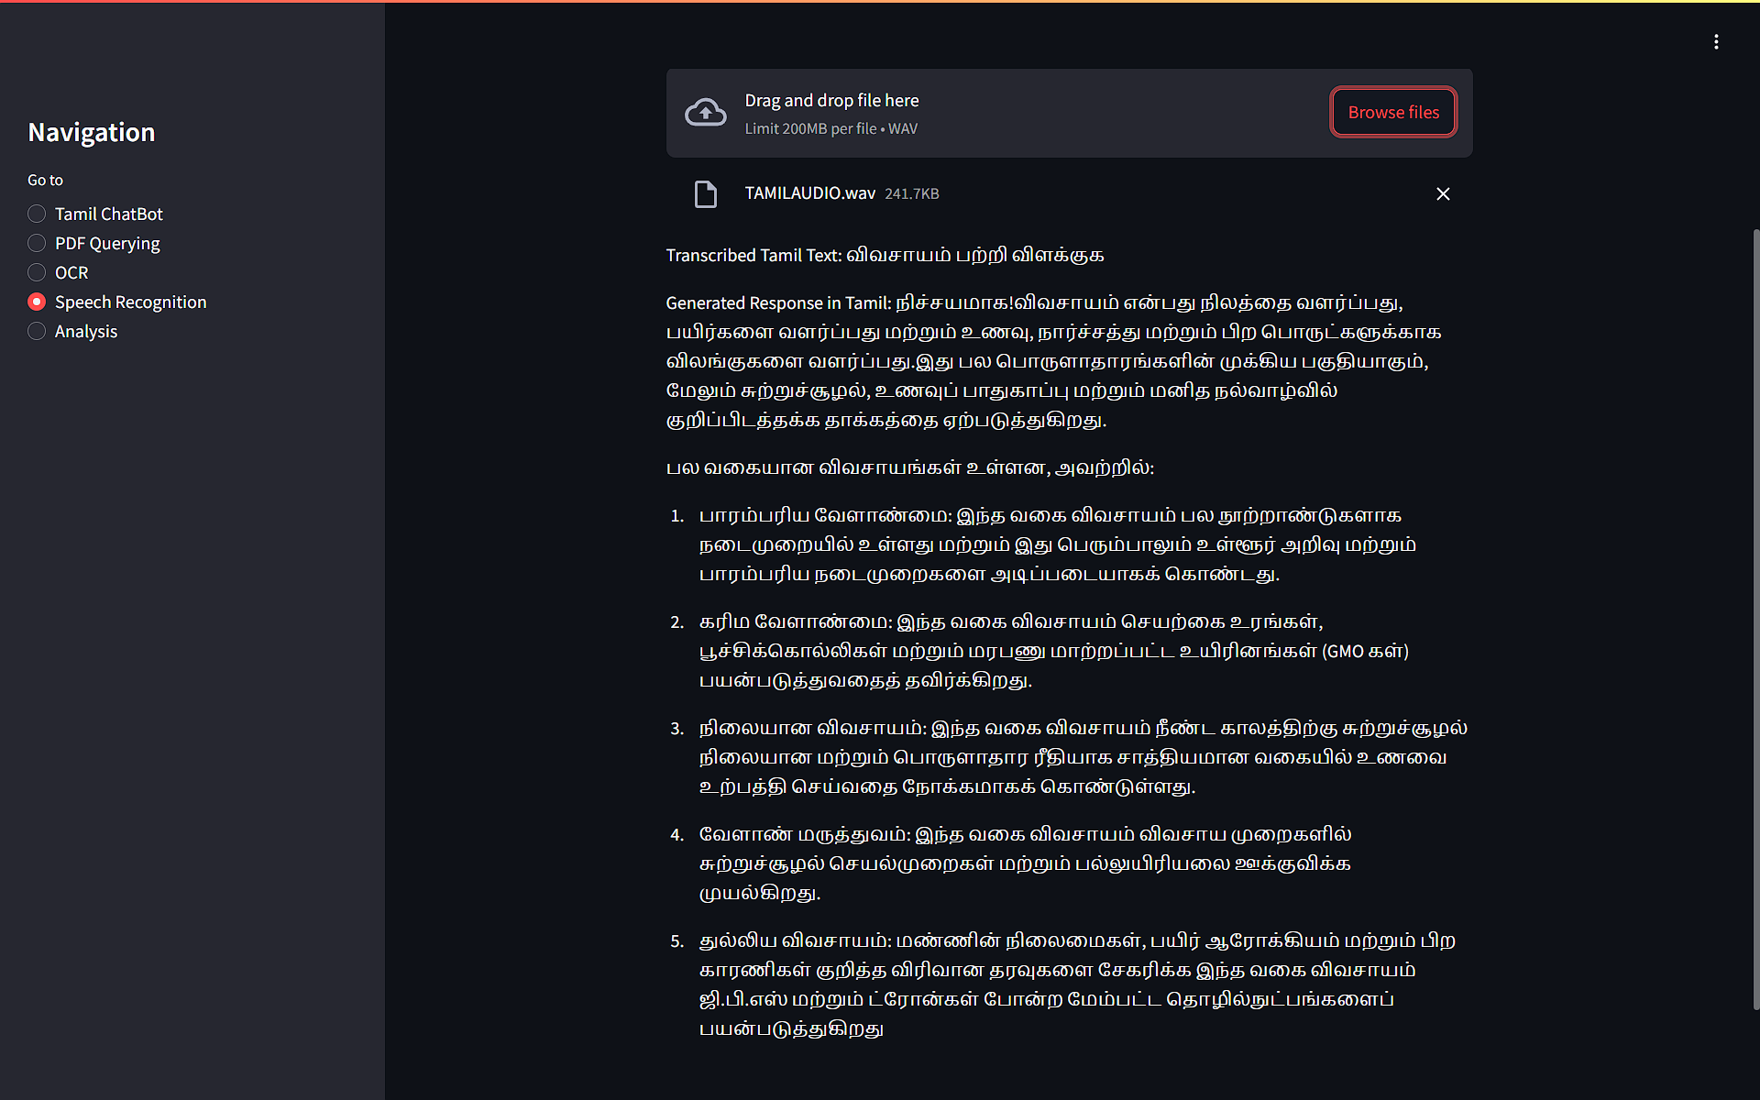

Slide 20
06
Results and discussions

Slide 21
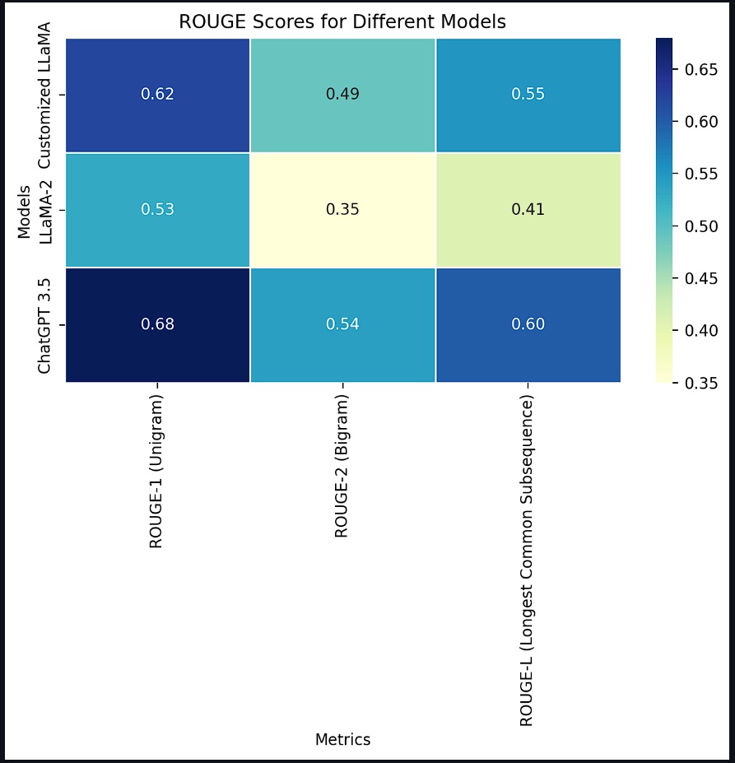
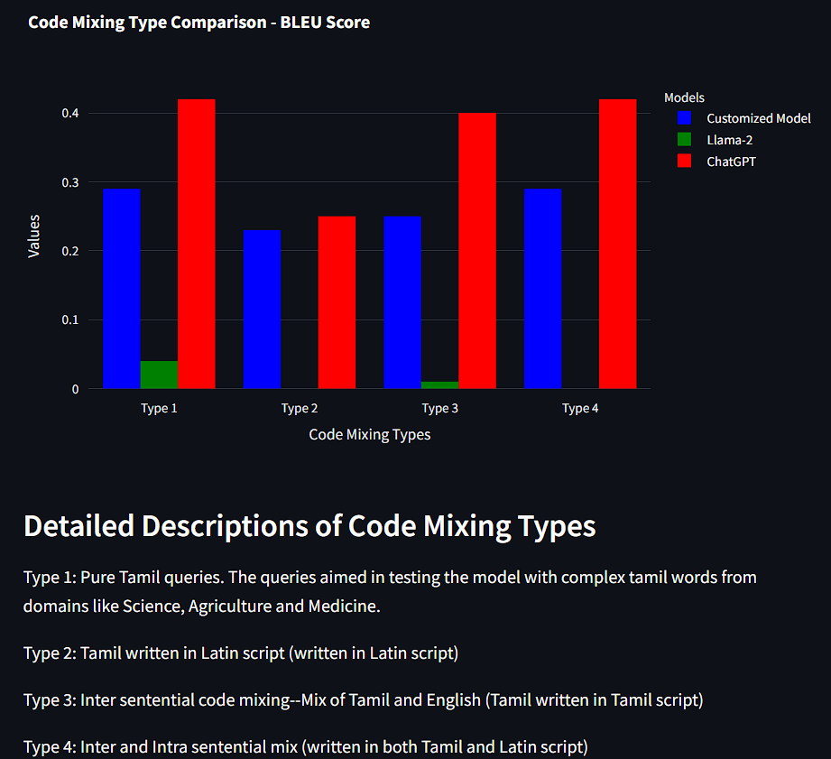
Results

Slide 22
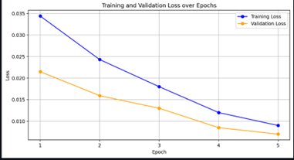
Discussions
Results show that Our Customized Llama2 Model has better accuracy than base Llama2 model for code mixed tamil queries.
BLEU score was used to evaluate the quality of text generation and Rouge score was used to evaluate the quality of text summarization.
Our Transliterated Model’s loss is not sufficient enough to surpass the Google Translate’s Transliteration.
Our Customized Llama2 model is capable of generating responses related to recent trends as we feed the content through web scraping.

Slide 23
References
Muhammad Farid Adilazuarda, Samuel Cahyawijaya, Genta Indra Winata, Pascale Fung, and Ayu Pur warianti. 2022. IndoRobusta: Towards robustness against diverse code-mixed Indonesian local lan guages. In Proceedings of the First Workshop on Scaling Up Multilingual Evaluation, pages 25–34, Online. Association for Computational Linguistics.
Alham Fikri Aji, Genta Indra Winata, Fajri Koto, Samuel Cahyawijaya, Ade Romadhony, Rahmad Mahendra, Kemal Kurniawan, David Moeljadi, Ra dityo Eko Prasojo, Timothy Baldwin, Jey Han Lau, and Sebastian Ruder. 2022. One country, 700+ lan guages: NLP challenges for underrepresented lan guages and dialects in Indonesia. In Proceedings of the 60th Annual Meeting of the Association for Com putational Linguistics (Volume 1: Long Papers), pages 7226–7249, Dublin, Ireland. Association for Computational Linguistics.

Slide 24
Conclusion
In this project we have successfully developed a customized model for Tamil language that integrates several advanced functionalities, showcasing significant achievements in Generative AI and Large Language Models. We were able to address the issue of code mixing in user queries.
Overall, this project demonstrates the effective application of cutting-edge NLP techniques to address specific linguistic needs, providing a robust tool for Tamil language users.
The integration of chat, document processing, OCR, and speech recognition establishes a versatile platform that can be further expanded for more complex applications in the future.

